Slide 1
Graph Theory Algorithms
Djikstra

Slide 2
Dijkstra's Shortest Path
Single source shortest path
Shortest path from one node to every other node
Must have positive weighted edges
O(V²) for slow implementation
O(ElogV) for priority queue implementation

Slide 3
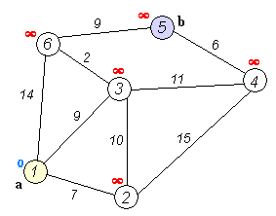
General Idea
Assume source is node V
From node V, initialize distances to every other node as INFINITY
At every iteration, choose closest node to node V that is unselected and update the distances of all adjacent nodes with the minimum distance from node V

Slide 4
Intuition
Why does this work?
Assume you take node U at some iteration, it is guaranteed that the distance currently recorded from V to U is the shortest distance possible from V to U. This is because we take the current unselected node with the shortest distance to node V. This means all other nodes have greater distance to V and could not have updated U with a shorter distance
This is why you must have positive weighted edges

Slide 5
Slow Implementation
Use this if n^2 is approximately equal to the number of edges:
Initialize distance array (fill with max value except for start node) and boolean vis array
Loop n times
Loop to find the node with smallest distance that has not been visited
If there is none, exit the loop
Mark the node as visited
For all edges connected to this node, update the distance to its connected nodes if its current distance is larger
The distance array should have the shortest distance from the start node to every other node that it can visit

Slide 6
Priority Queue Implementation
Java: PriorityQueue pq = new PriorityQueue();
pq.add(9); // add operation pq.poll(); // get operation
C++: priority_queue<int, vector<int>, greater<int>> pq; // gets smallest
priority_queue<int> pq; // gets largest
pq.push(9); // add operation pq.top(); // get operation

Slide 7
Examples
Implementing Dijkstra's: https://dmoj.ca/problem/sssp
https://dmoj.ca/problem/ccc15s4

